Slide 1
SEO AUDIT AND OPTIMIZATION

Slide 2
COMPANY
I selected the gofrugal website https://www.gofrugal.com/about.html
Cloud and ERP solutions to Retail, Restaurant and Distribution business.
They mainly helps to transform as a digital platform.
They help business to grow with minimal staff, least skill along with accurate solution.

Slide 3
INITIAL AUDIT
Using pagespeed.web
I found that the page is optimized properly.
PERFORMANCE:
In mobile the performance score is 64 out of 100.
In desktop it 97 which way better than mobile.

Slide 4
KEYWORD RESEARCH
TOOL USED:GOOGLE KEYWORD PALANNER
Primary keyword:
pos 11 in medical billing, pos 21 in medical billing, pos22 in medical billing,pos system, pos systems.
Secondary keyword:
pos software, pos system software, pos solutions,the modification method and the numerical solution of ill-posed problems.
Low impact keywords:
gofrugal, pos solutions,pos software solution,retail management solution pos

Slide 5
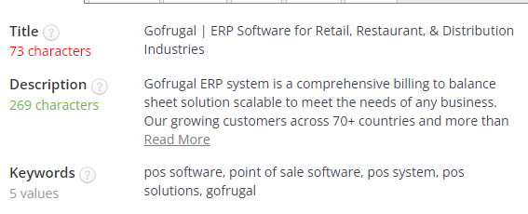
ON-PAGE SEO OPTIMIZATION AUDIT
LINK:https:// www.gofrugal.com/

Slide 6
1. Title is optimized properly with the target keyword.
Meta description is not optimized properly as the target key word is not present in the description.
2. keyword: pos software, point of sale software, pos system, pos solutions, Gofrugal.
Key words are not optimized properly.
3.Internal linking and external structure: there is no internal linking in this page.
4.Alt tags in images are utilized properly with the target keyword and the file names are well descriptive.

Slide 7
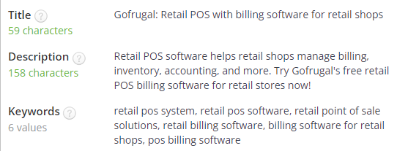
PAGE-2
WEBSITE LINK:https: https://www.gofrugal.com/retail/

Slide 8
1.Title and meta description is optimized properly keywords are mentioned in both.
2.KEYWORD: Retail pos system, retail pos software, retail pos solution, retail billing software, billing software for retail shops, pos billing software. Key word stuffing is happened in this page the term pos billing is mentioned more than five times.
3.Internal links present in this page.
4.Alt tabs in image in this page is optimized properly with the target key word.

Slide 9
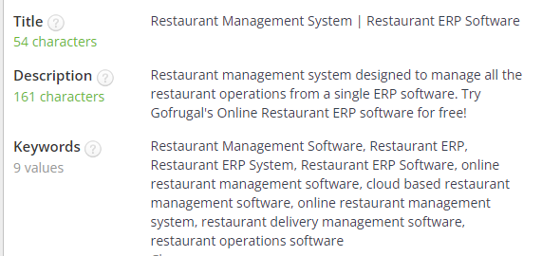
PAGE 3
LINKS: https://www.gofrugal.com/restaurant/

Slide 10
1.Title and meta description optimized properly.
2. KEYWORD: restaurant management system is overused so there is keyword stuffing spotted in this page.
3. Internal links: There is no interlinks spotted in this page.
4.The images ALT Tabs are with optimized with target keyword.

Slide 11
TECHNICAL SEO
PAGE SPEED TEST:https://pagespeed.web.dev/
HOMEPAGE: The load time for this website is 1.75 seconds.
WEB PAGE 1: LOAD TIME 2.83 SECONDS
WEB PAGE 2: LOAD TIME 1.40 SECONDS
WEB PAGE 3:LOAD TIME: 2.54 SECONDS
From the above test the website is optimized properly.

Slide 12
BEST PRACTICES
Responsive design: Ensure the website adapts seamlessly to different screen sizes, from smart phones to tablets.
Mobile- first Approach: Prioritize mobile users by designing for smaller screens first.
Page speed: optimize loading times for mobile devices to improve user experience.
Visual Appeal: Use visually appealing design elements that align with your brand .
Create valuable, informative, and engaging content that resonates with the target audience.

Slide 13
CONTENT STRATEGY
BLOG TOPICS:
1. How this company Transformed Their Operations with POS Software.
2. Using POS Analytics to Drive Business Growth.
3. How to Set Up and Configure Your POS System.
Create informative blog post and case studies.
Promote content on social media platforms.

Slide 14
OFF-PAGE SEO
Guest posting: Write informative articles for relevant blogs and websites.
Social media sharing:Share your content on social media platforms to increase visibility and potentials backlinks.
Email outreach: Reach out to influencers and industry experts to promote your content and potentially earn backlinks.
Social media Engagement: Actively participate in online discussions and coversation related to your industry.

Slide 15
CONCLUSION
SEO strategy can make a business to grow more than its actual growth by making more traffic using target keywords which make more efficient when it comes to reach the target customers.

Slide 16
THANK YOU

